Slide 1
SPECSCOUT
Mobile Specification
Tracker
A data-driven view of smartphone specifications,
price segments and model comparisons
DATA ANALYTICS & VISUALIZATION | 2026–27
Presented by
B. Sathwik • T. HariswaraBrahmam • A. Saiteja
Guided by Dr. Neetu Prasad | SR University
01

Slide 2
Project overview
01 • OVERVIEW
What is SpecScout?
SpecScout organises smartphone specifications into an analytical view that helps users compare models by price, rating, brand and hardware features.
PROJECT SNAPSHOT
CLEANED RECORDS
BRANDS
789
42
Smartphone entries
Represented in data
DATA SOURCE
PLATFORM
Kaggle
Power BI
Smartphone dataset
Interactive dashboard
Dataset fields include price, rating, RAM, storage, battery, display, camera, processor and network support.
SPECSCOUT • MOBILE SPECIFICATION TRACKER
02
02 / 12

Slide 3
Problem statement & objectives
02 • PURPOSE
THE CHALLENGE
PROJECT OBJECTIVES
Smartphone buyers face many models with different prices and specifications. Comparing them manually can be time-consuming and makes it harder to identify suitable options.
Organise smartphone data from Kaggle.
Clean and structure key specification fields.
Analyse brands, prices, ratings and hardware.
Visualise patterns using charts and KPIs.
SpecScout turns a large product table into clear summaries, charts and filters.
Build an interactive dashboard for filtering models.
SPECSCOUT • MOBILE SPECIFICATION TRACKER
03
03 / 12

Slide 4
Dataset at a glance
03 • DATA
RAW RECORDS
CLEANED RECORDS
VARIABLES
BRANDS
1,074
789
17
42
Kaggle Excel source
Used for analysis
Cleaned dataset columns
Unique brands
Key variables
Brand
Model
Price (INR)
Rating
RAM (GB)
Storage (GB)
Battery (mAh)
Display size
5G support
OS family
SPECSCOUT • MOBILE SPECIFICATION TRACKER
04
04 / 12

Slide 5
Data cleaning & preparation
04 • PREPARATION
01
Load
02
Standardise price
03
Extract RAM & storage
Read the source Excel workbook using pandas.
Remove ₹ and commas; convert price text to numeric.
Use regular expressions to convert GB, MB and TB values.
04
Extract battery
05
Create brand
06
Export
Identify battery capacity in mAh.
Derive brand from the smartphone model name.
Save the transformed records as a CSV dataset.
Tools: Python • pandas • NumPy • Regular Expressions
SPECSCOUT • MOBILE SPECIFICATION TRACKER
05
05 / 12

Slide 6
Key analytical findings
05 • INSIGHTS
AVERAGE PRICE
AVERAGE RATING
AVERAGE RAM
TOTAL PHONES
₹27.87K
77.62
6.06 GB
789
Dashboard KPI
Dashboard KPI
Dashboard KPI
Dashboard KPI
What the dataset reveals
Samsung has the largest model count, followed by Xiaomi and vivo.
Entry price segment (₹10,000–₹20,000) is the largest group.
The 80–89 rating band is the most common.
8 GB, 6 GB and 4 GB are the most frequent RAM capacities.
128 GB is the most common storage capacity.
SPECSCOUT • MOBILE SPECIFICATION TRACKER
06
06 / 12

Slide 7
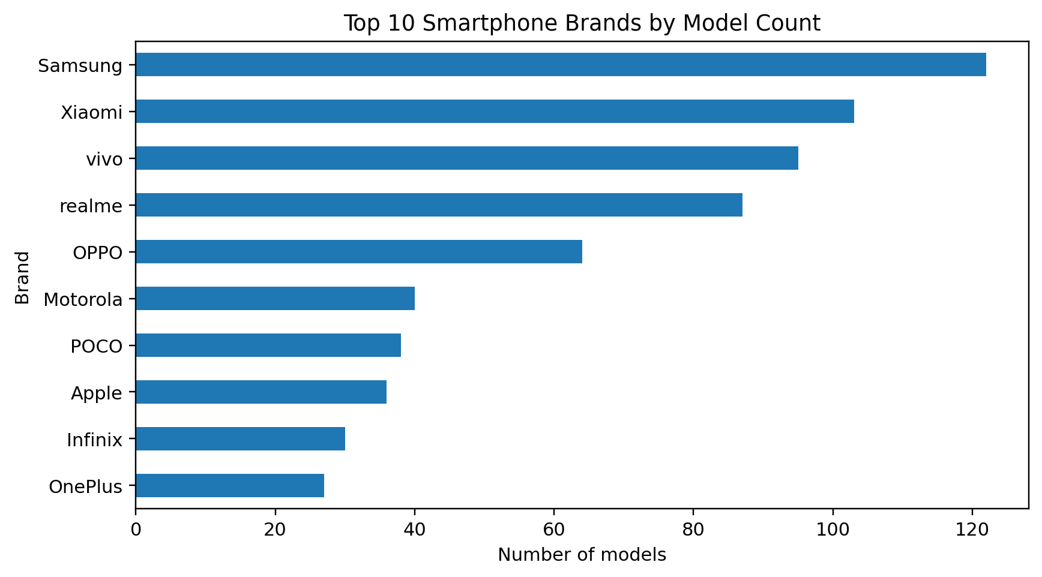
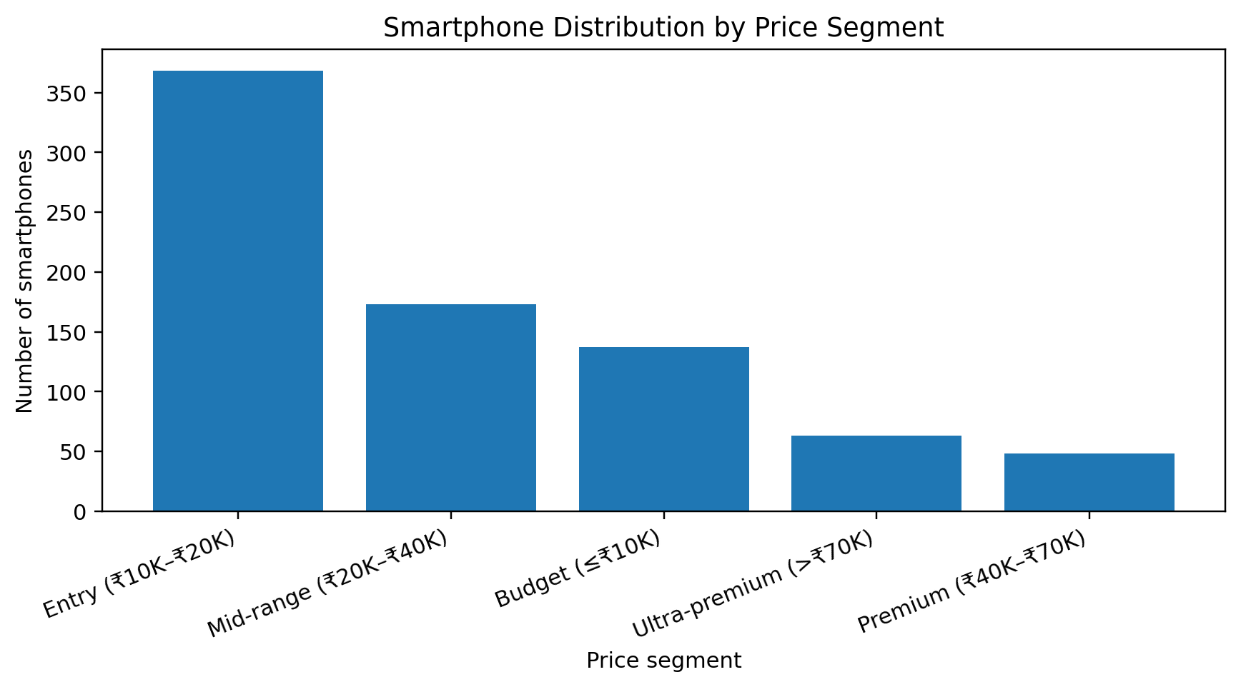
Brand & price-segment patterns
06 • VISUAL ANALYSIS
Brand representation
Price segment distribution
SPECSCOUT • MOBILE SPECIFICATION TRACKER
07
07 / 12

Slide 8
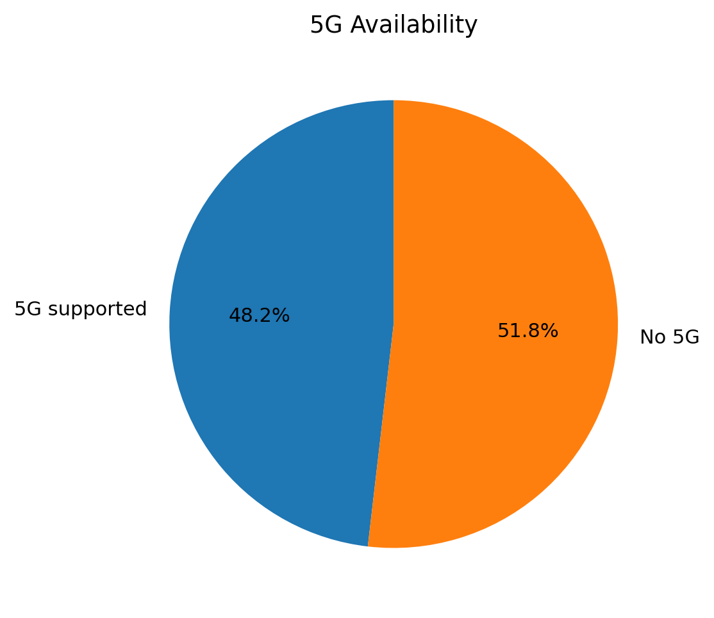
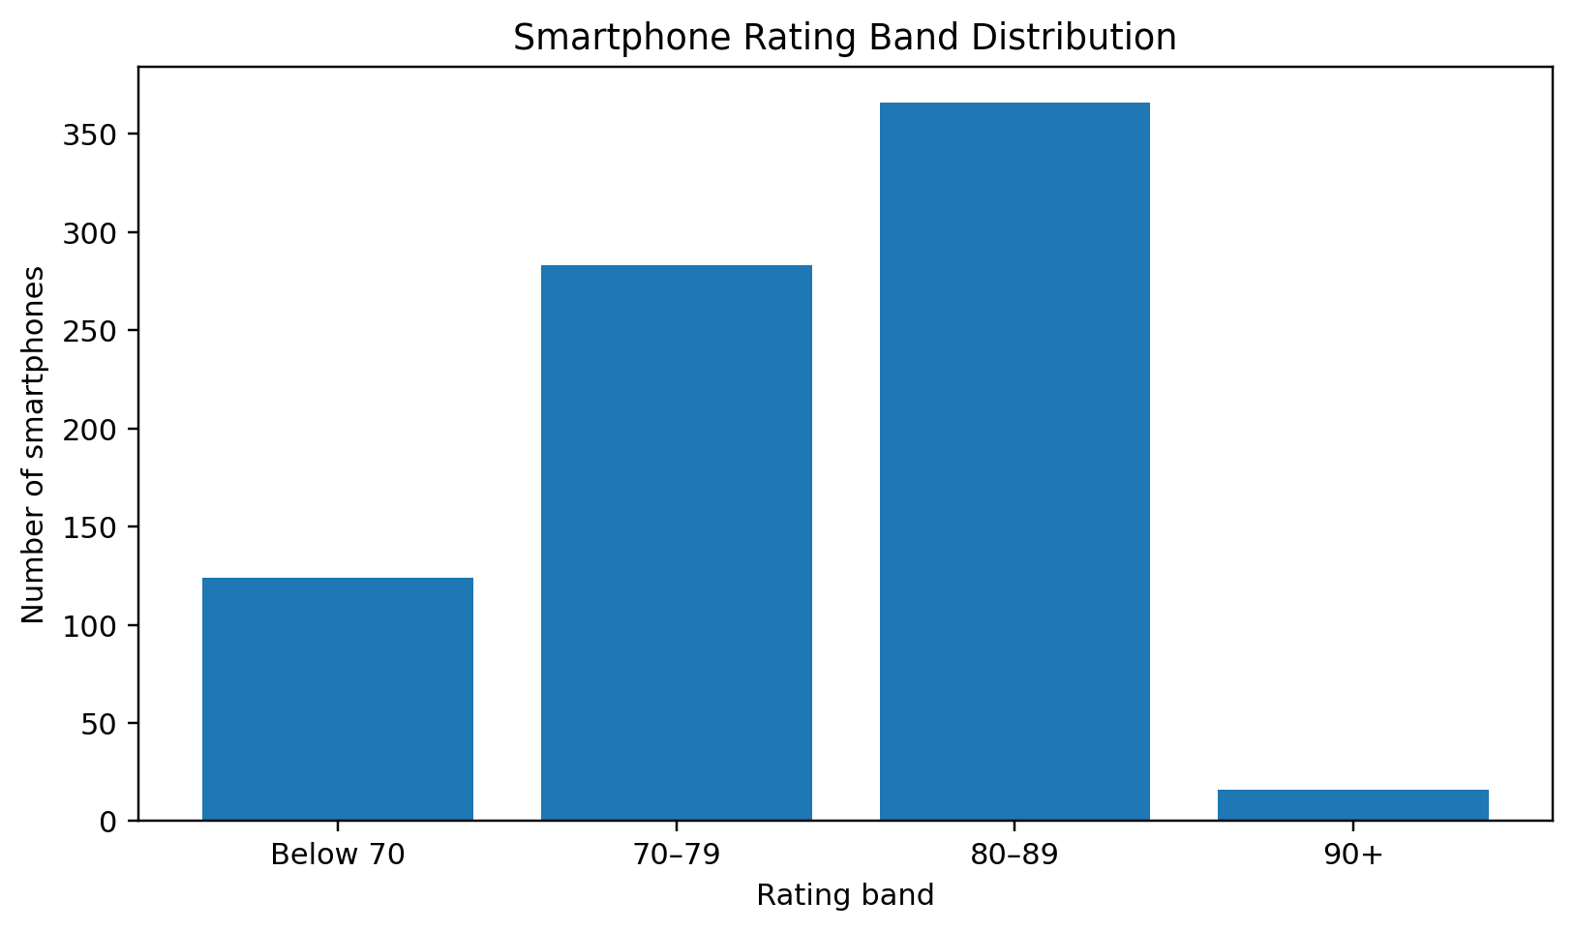
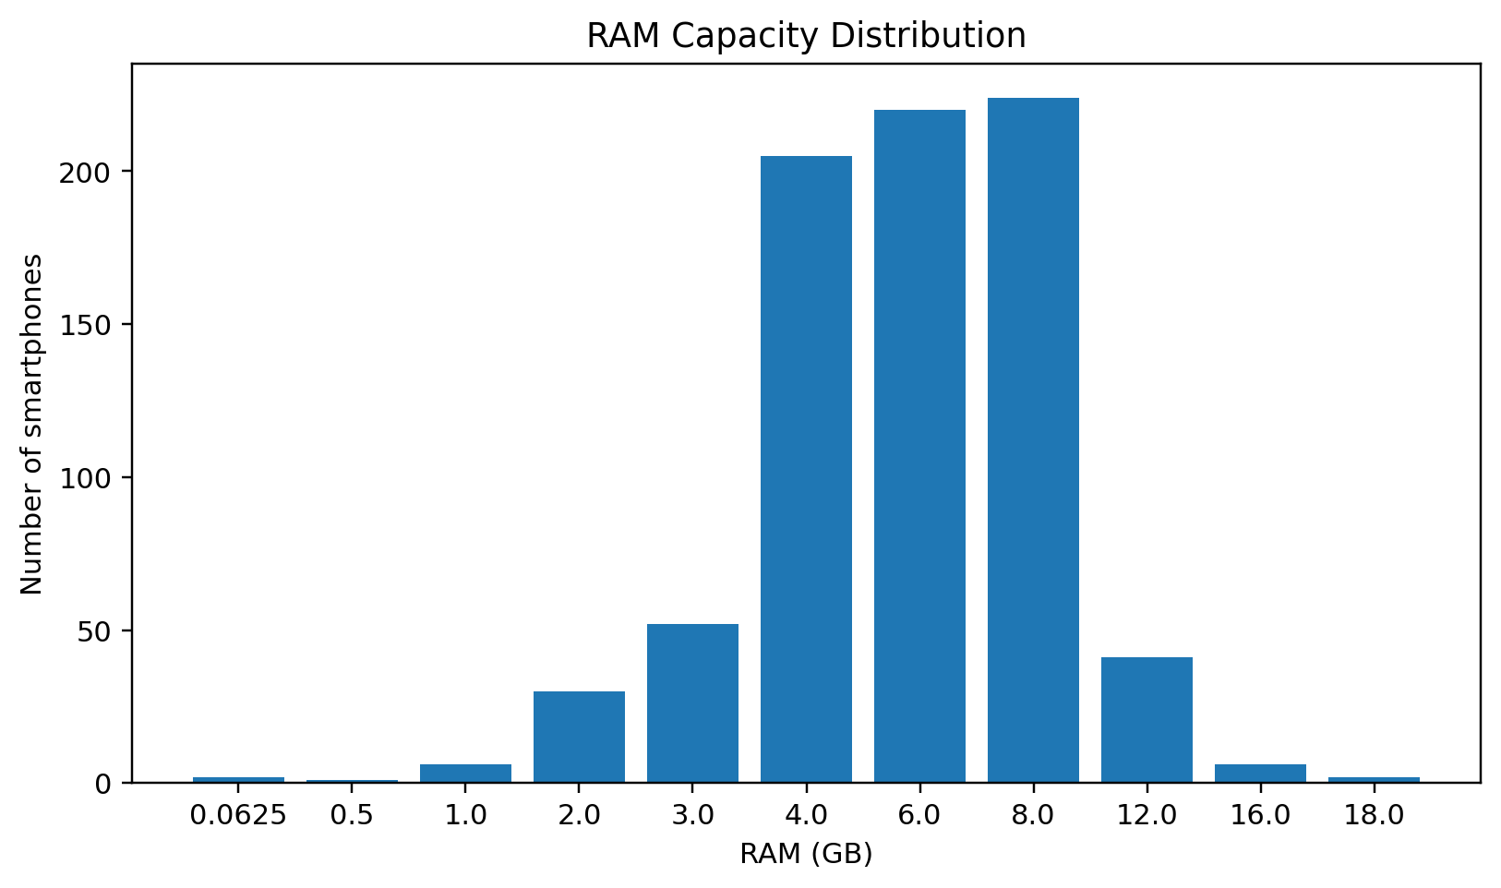
Specification patterns
07 • VISUAL ANALYSIS
Ratings cluster around the 80–89 band.
8 GB, 6 GB and 4 GB RAM are common.
5G is available in 48.2% of records.
SPECSCOUT • MOBILE SPECIFICATION TRACKER
08
08 / 12

Slide 9
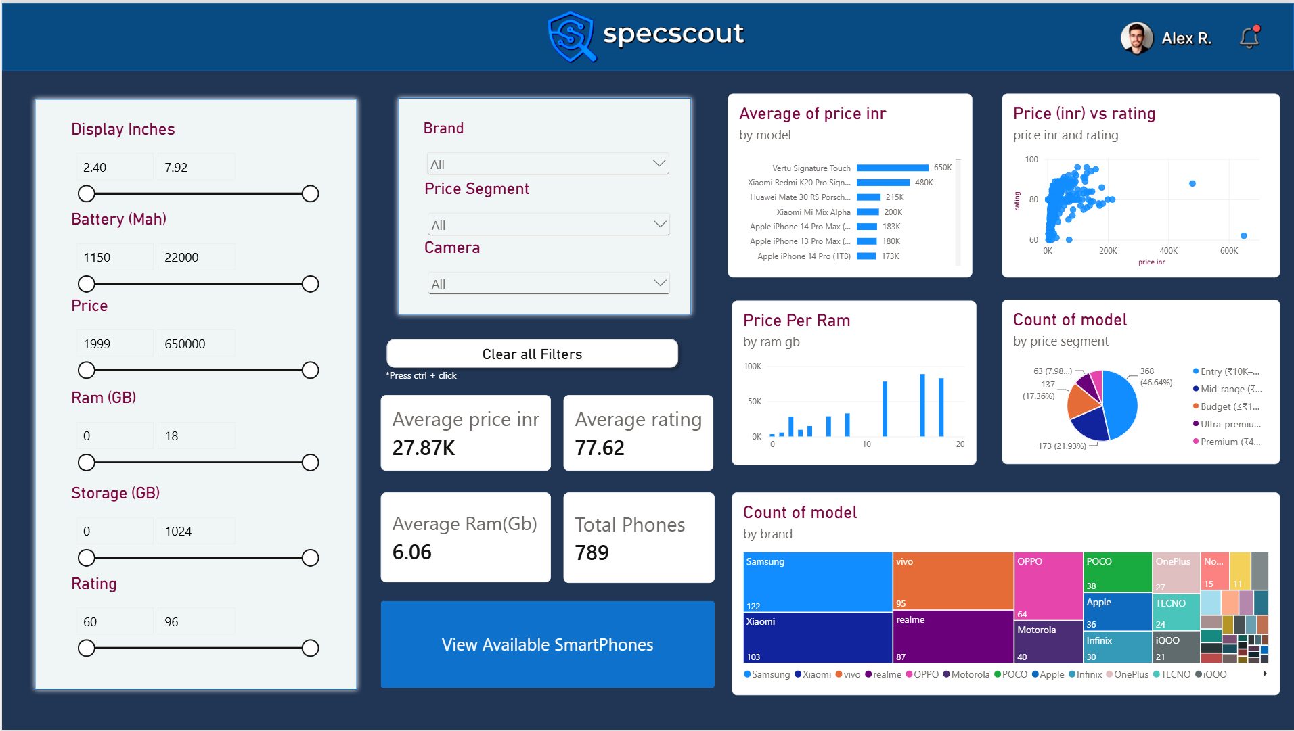
INTERACTIVE POWER BI DASHBOARD
Explore. Filter. Compare.
Main dashboard • KPI cards • specification filters • brand and price insights
09

Slide 10
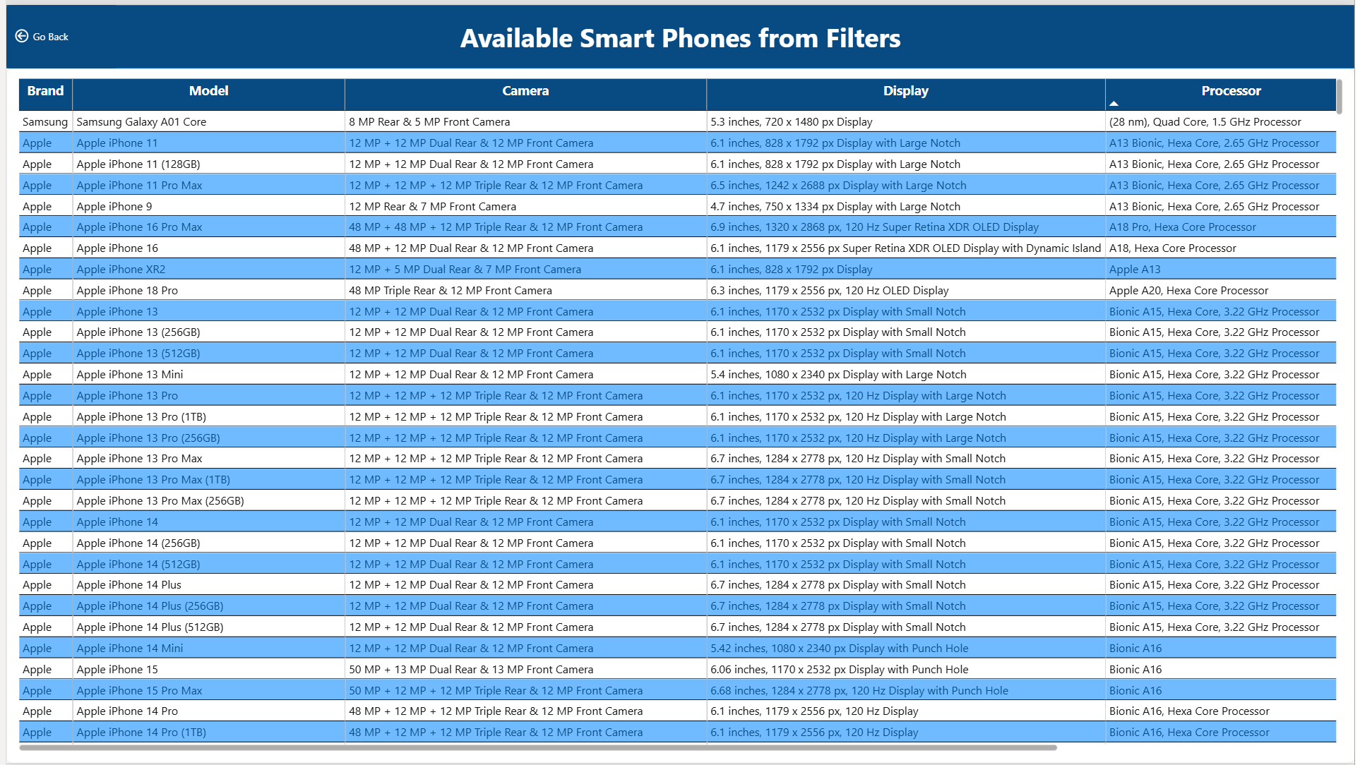
Available smartphones from filters
08 • DASHBOARD DETAIL
The filtered listing presents brand, model, camera, display and processor details in a comparison table.
SPECSCOUT • MOBILE SPECIFICATION TRACKER
10
10 / 12

Slide 11
Conclusion & limitations
09 • WRAP-UP
CONCLUSION
LIMITATIONS
SpecScout transforms smartphone specification data into a structured comparison experience.
Dataset is a snapshot, not live market data.
No dated historical prices are available for price-trend analysis.
Highlights brands, price tiers and specification patterns.
Some source fields are incomplete or inconsistent.
Combines descriptive analytics with interactive filtering.
Price-rating correlation does not prove causation.
Supports clearer, data-informed smartphone comparisons.
SPECSCOUT • MOBILE SPECIFICATION TRACKER
11
11 / 12

Slide 12
NEXT STEPS
Making smartphone
comparison smarter.
Connect verified, regularly updated prices.
THANK YOU
Add price history and target-price alerts.
Improve processor and camera evaluation metrics.
Extend recommendation and comparison features.
B. Sathwik • T. HariswaraBrahmam • A. Saiteja
SR UNIVERSITY | 2026–27
12

